Slide 1

Wrench Monkey
Group 9:
Matthew Crespo - EE
Matthew Trump - CpE
Rachael Sak - EE
William Wandelt - EE

Slide 2

Motivation
Expand the uses for toolboxes in shared workspace environments
Allow for seamless collaboration between workers
Current tool tracking methods are inadequate for an increased number of users

Slide 3
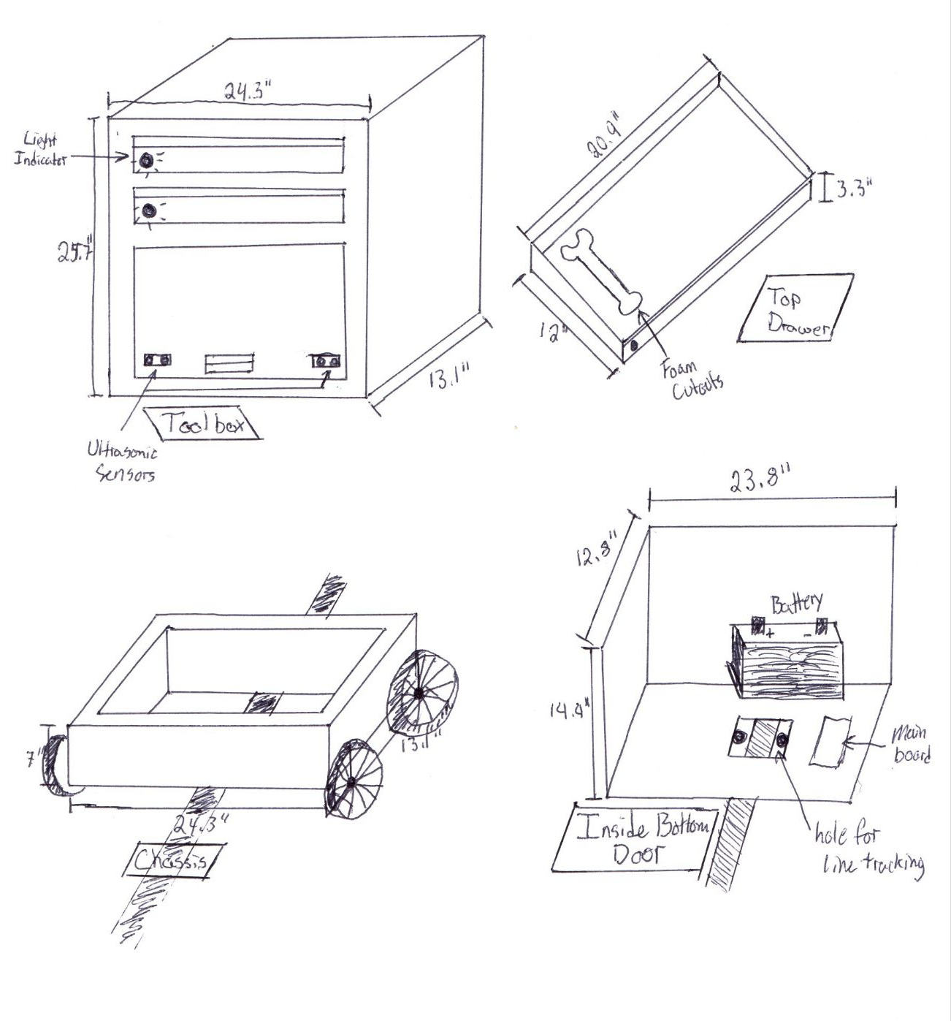
Overview
Create an autonomous robotic toolbox that will navigate between workspaces
Develop a tool tracking system
Create a user interface that allows tool requests to be sent

Slide 4
Workload Distribution
Task Description | Primary Team Member | Secondary Team Member
Research RFID | William Wandelt | Rachael Sak
Research Motors | William Wandelt | Matthew Crespo
Research Pressure Sensor | Rachael Sak | William Wandelt
Research Color Sensor | Matthew Crespo | William Wandelt
Research Cameras | Matthew Crespo | Matthew Trump
Research Microcontrollers | Matthew Trump | Matthew Crespo
Research Full Stack Productions | Matthew Trump | Rachel Sak
Research Controllers | Matthew Crespo | William Wandelt

Slide 5

Engineering Specifications
Motorized Carrier
Carrier Weight (exc. battery) | < 7 kg.
Carrier Weight Capacity | ≤ 15 kg
Power Consumption | < 5W idle
Speed | > 0.5 m/s
Battery Runtime | > 5 hours mixed use
Dimensions (LxWxH) | 0.6m x 0.3m x 0.2m
Maximum Working Area | 40 sq. m
Toolbox
Weight (exc. battery) | < 20 kg.
Dimensions (LxWxH) | 0.6m x 0.3m x 0.9m
Tool Capacity | >= 4 tools
Overall Project
Dimensions (LxWxH) | 0.6m x 0.3m x 1.1m
Total Weight | < 40 kg
Communication Frequency | 2400 MHz
Voltage Input | 12V
Obstacle Detection Range | > 1m
Color Detection Range | 380-700nm
Cost | < $1000
Notes:
The table shown here displays the engineering specifications for the Wrench Monkey. For our demo, we plan to show the highlighted requirements, which are the minimum tool capacity, the minimum speed, and the weight capacity.

Slide 6
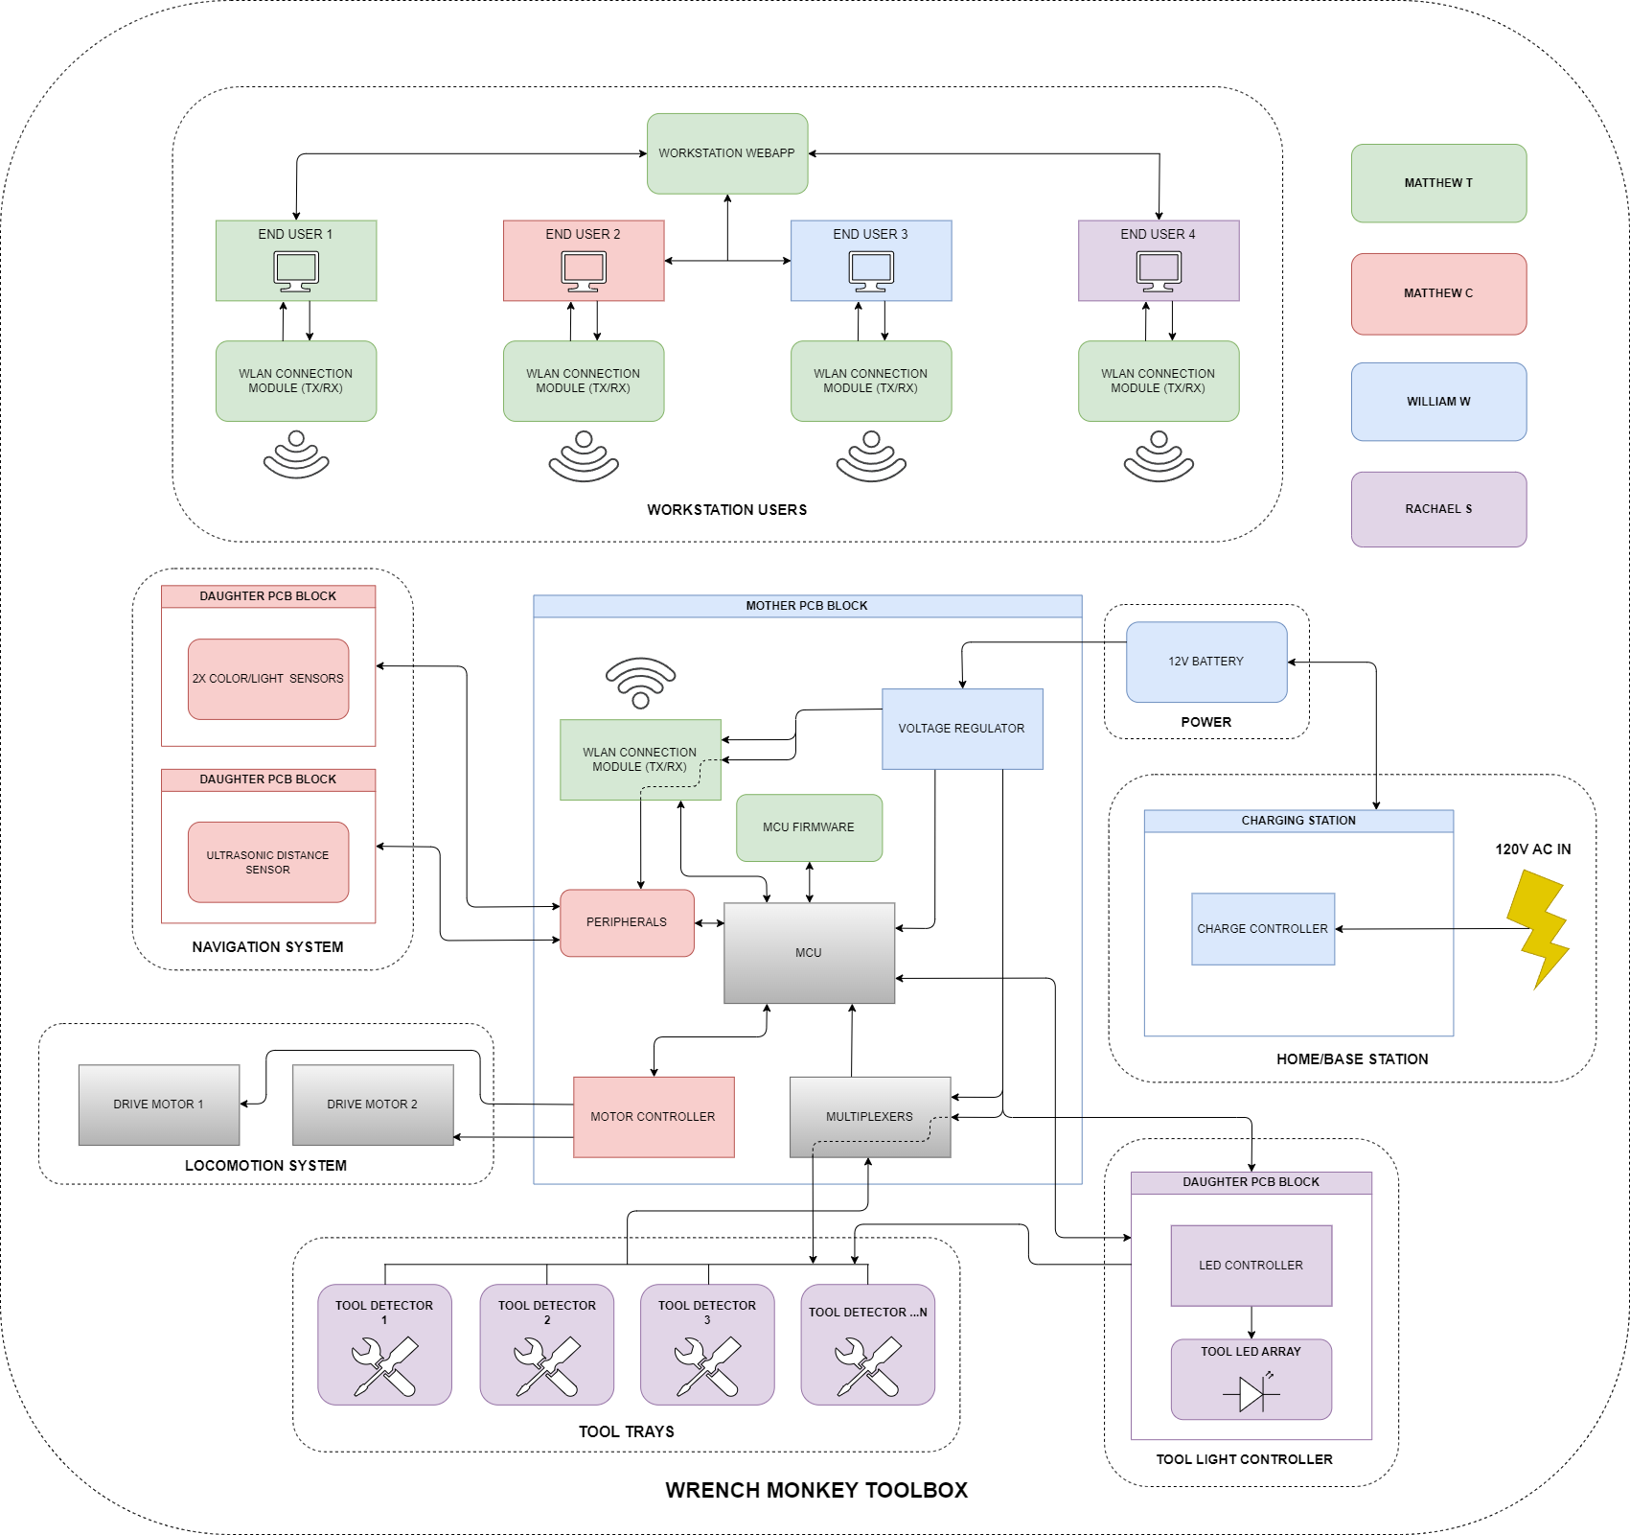
Hardware Block Diagram

Slide 7
Hardware Block Diagram

Slide 8
Control Technique Comparison and Selection
Control Technique | Mathematical Modeling Required | Tuning Method
Bang-Bang | No | -Trial and error
PID | No | -Trial and error -Ziegler Nichols
MPC | Yes | -Changing objective function
RL | No | -Change rewards -Change reward structure

Slide 9

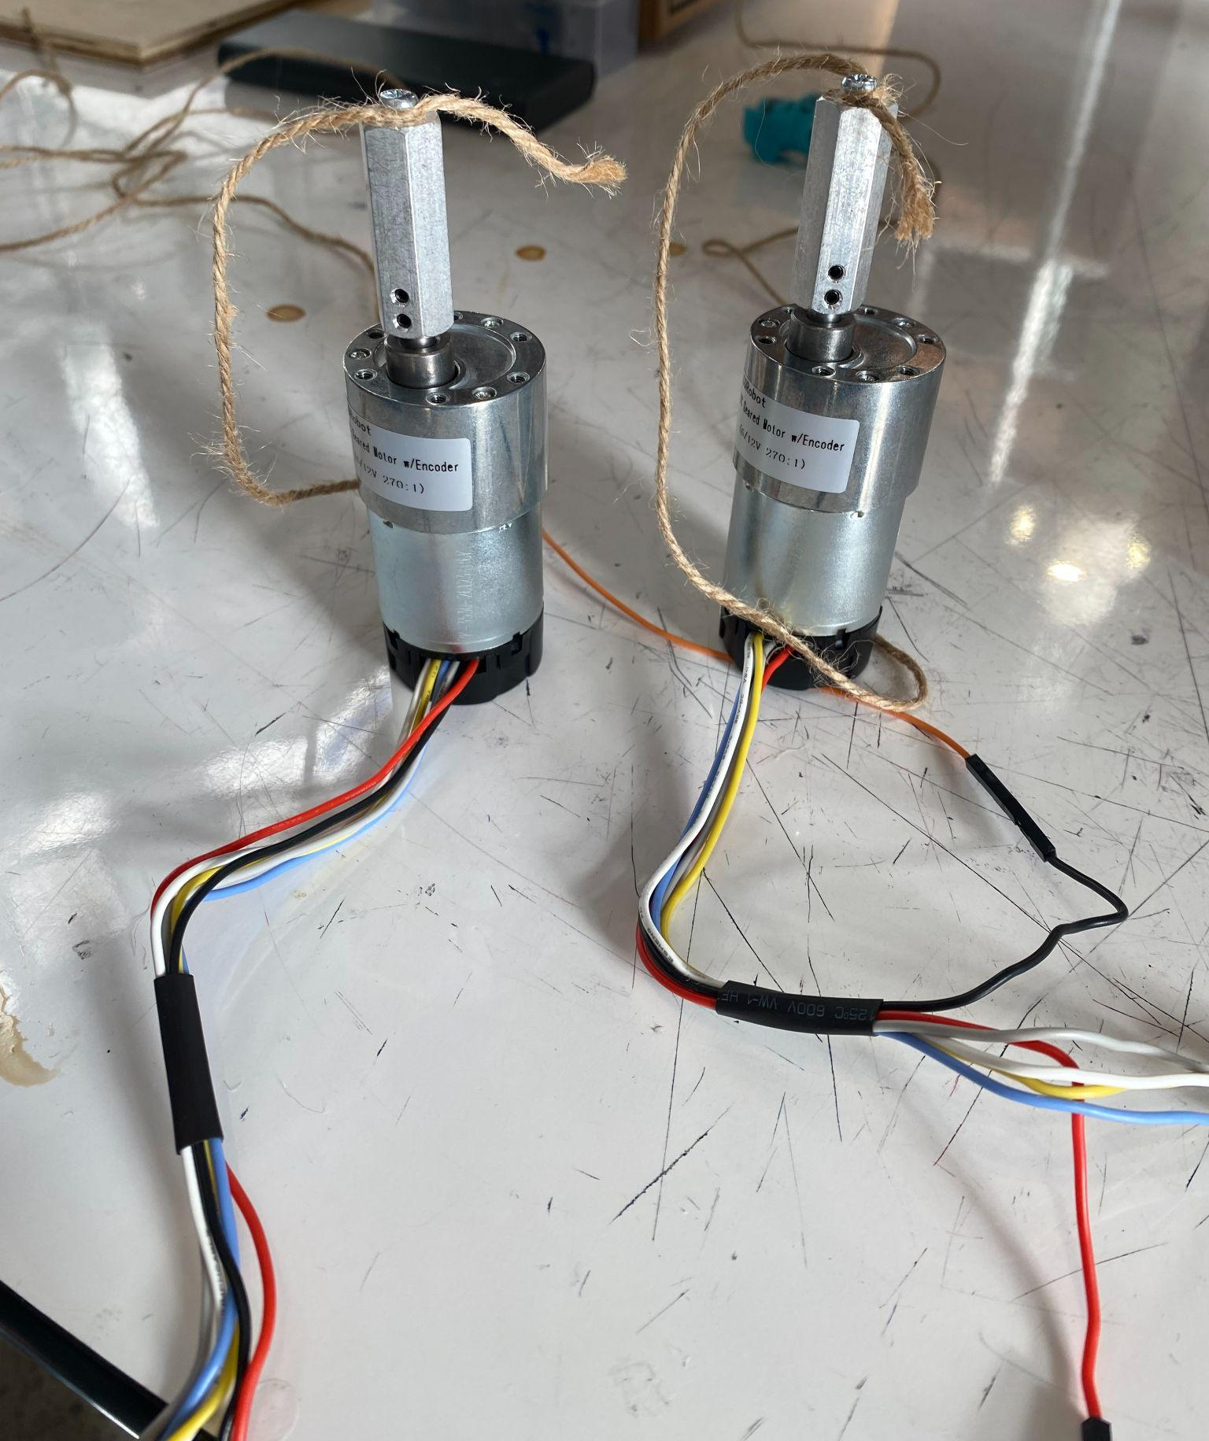
Motor Type Comparison and Selection
Motor Type | RPM | Torque | Precision | Ease of Control | Size
Brushed DC | High | Low | Low | Easy | Large
BLDC | High | Medium | Low | Complex | Medium
Stepper | Low | High | High | Complex | Large
Servo | Varies | High | High | Easy | Small
Motor Choice | Cost | Torque | Mounting Style | Documentation
CQRobot | $33 | 70kg.cm | Parallel | Yes (Wiki)
Walfront | $16 | 25kg.cm | Perpendicular | No
Notes:
When deciding what motor type to use, heavy emphasis was put on the torque output capabilities and RPM of the motor itself. The high weight of the project, coupled with the need to move relatively quickly, meant that a balance between output torque and RPM needed to be made.
This requirement excluded brushed and brushless DC motors from our selection, as the RPM of these motors is too high, while the torque is too low. Additionally, due to the budget and complexity-conscious nature of our project, stepper motors were excluded due to the lower RPM and need for additional control circuitry to operate.
This left servo motors as our selection for use in the project. Specifically, the CQRobot CQR37D with an output RPM of 40 and output torque of 70kg*cm. The high RPM, high torque, and dual rotary encoder feedback made this motor perfect for our use case. The available documentation from the manufacturer’s website also makes integration
Extremely simple as there is no need to guess or experiment what each wire does or how to connect it properly.

Slide 10
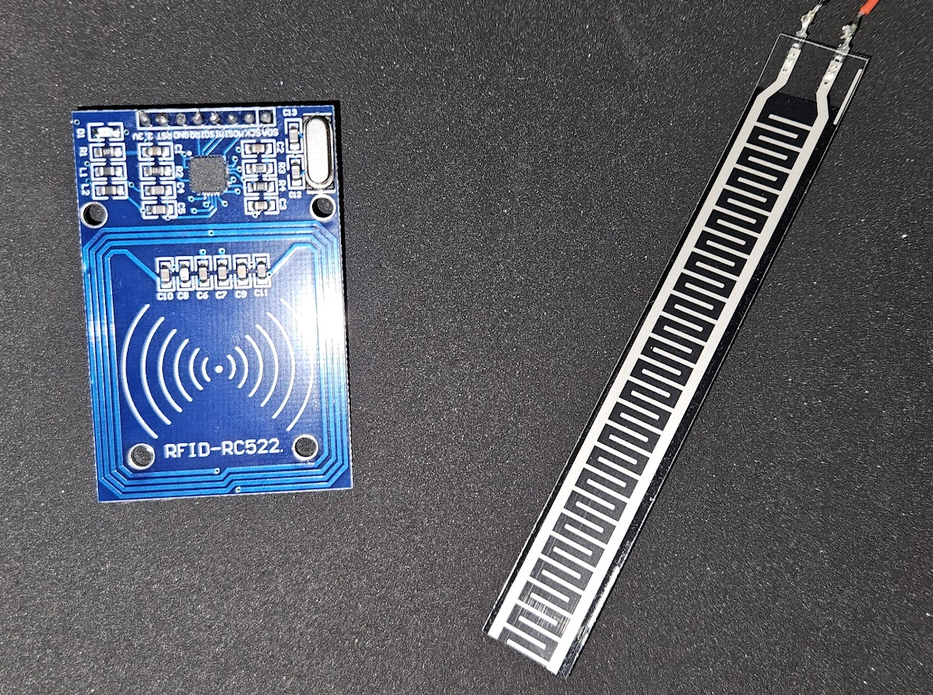
Tool Detection Sensor Comparison and Selection
Sensor Type | Cost | Complexity | Accuracy
Strain Gauge | Low | Low | Low
Capacitive | Medium | Low | Medium
Photoelectric | Medium | Medium | High
RFID | High | High | High
Tool Detection | Cost | Pins Required | MTTF
HiLetGo RFID | $3.33 | 8 | 10+ years
Marhynchus Thin Film Strain Gauge | $6.00 | 2 | 2+ years
Notes:
Multiple tool detection methods were considered in our design. The main factors focused on were the price, size, and complexity to integrate. For our rudimentary tool detection, a simple resistive strain gauge is used, as it is small, cheap, and accurate enough for the purpose of binary tool detection. For the more complex tool detection, which can determine if a given tool is correctly placed in the right location, an RC522-based RFID reader is used. This will be in conjunction with programmed RFID tags attached to the tools to identify each to the system.

Slide 11
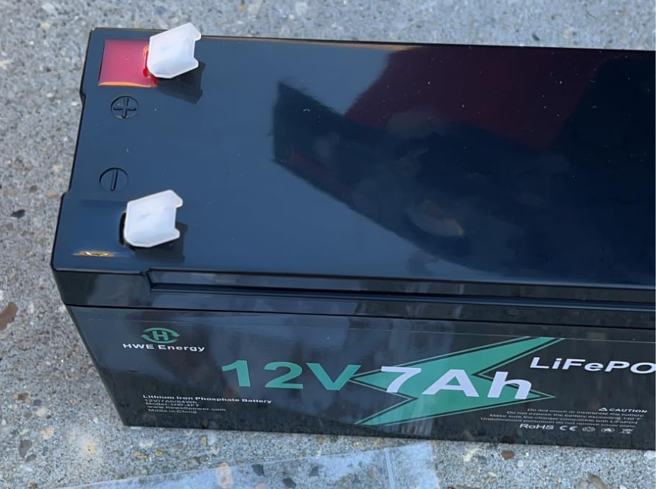
Battery Type Comparison and Selection
Battery Choice | Cost | Capacity | Footprint | Weight
NERMAK | $29 | 5Ah | 5.94 x 2.56 in. | 2.1 lbs
HWE Energy | $28 | 7Ah | 3.54 x 2.67 in. | 1.6 lbs
Battery Type | Cost | Weight | Energy Density | BMS Required
Lithium-Ion | High | Low | High | Yes
Sealed Lead-Acid | Low | High | Low | No
Nickel-Cadmium | Low | Medium | Medium | No
Notes:
When deciding what battery type to use, the biggest factor was the weight and capacity. A low weight was desired to reduce power consumption from the motors as well as keep the overall system weight down. A sufficiently high capacity was also needed, as to allow the system to operate for multiple hours between recharging. This lead to us selecting lithium ion batteries over the other chemistries available, as these types are known for low weight, small size, and high energy density.

Slide 12
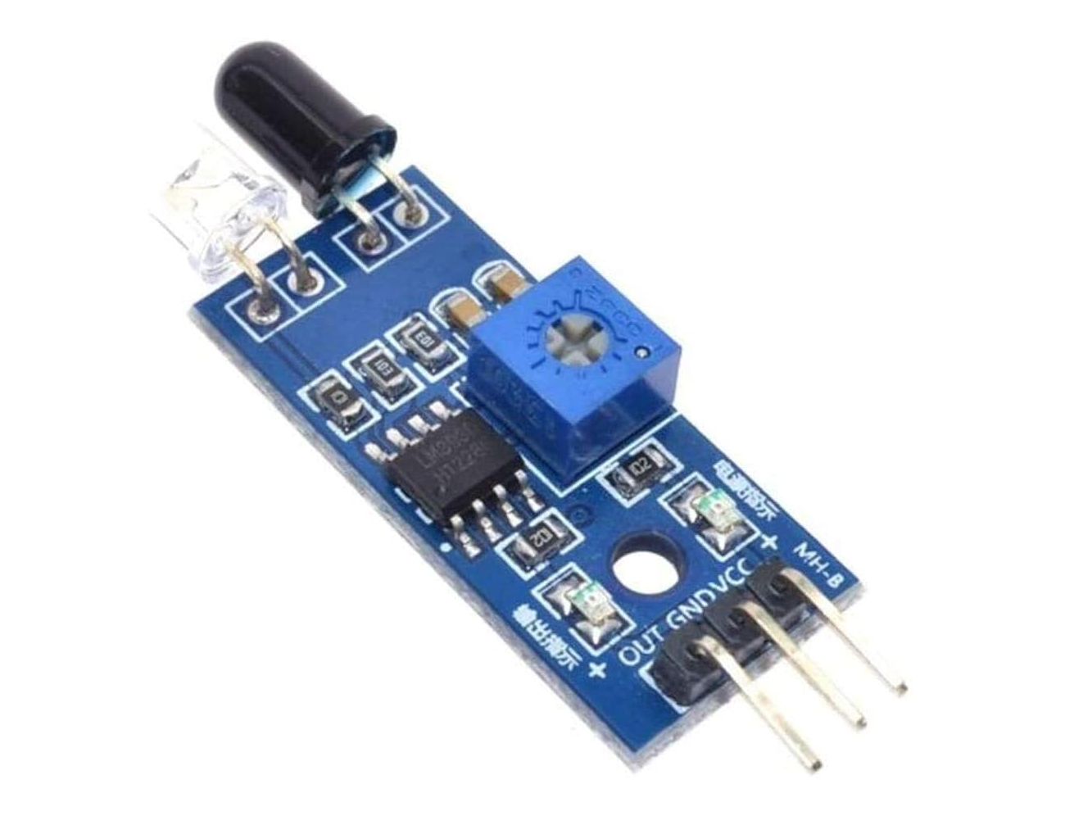
Line Detection Sensor Comparison and Selection
Line Detection Sensor | Power/IO Pins Required | Cost
Color | 4-8 | Medium
Camera | 18 | High
IR | 3 | Low
Notes:
For our method of line detection, which is integral to the functionality of our project, we opted to use common, low cost infrared sensors. These low cost, simple sensors make integrating a line following functionality simple by using between 2 and 5 individual sensors, and employing corrective control algorithms to ensure the system stays on track. Cameras and color sensors were considered, however these solutions either used too many IO pins, or required too much processor overhead for line recognition, such as in the case with the camera.

Slide 13
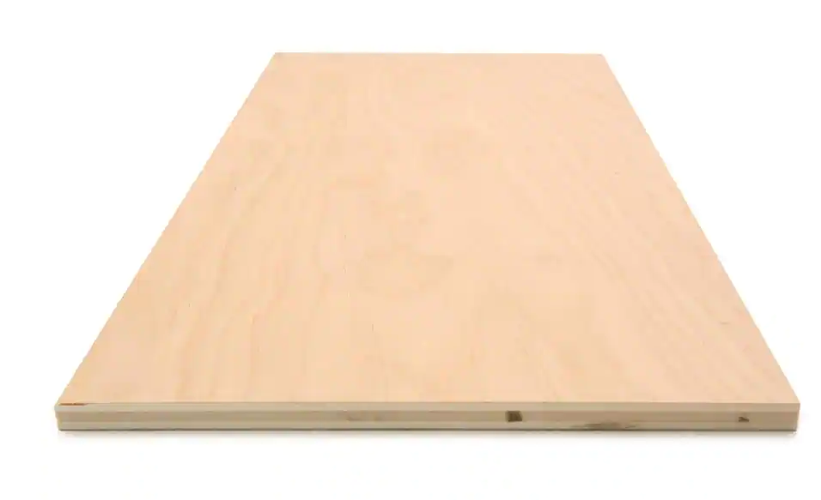
Chassis Base Material Comparison and Selection
Chassis Base Material | Cost | Strength | Ease of Manipulability
Wood | Low | Medium | High
Aluminum | High | High | Low (Machinery Required)
Plastic | Medium | Medium | Medium
Carbon Fiber | Very High | High | Low (Machinery Required)
Chassis Material | Cost | Compression Strength | Density
Plywood | $9 | 3,000-5,000 PSI | 39.6 lb/cu.ft.
OSB | $5 | 1,000-1,500 PSI | 37.5 lb/cu.ft
Notes:
The choice of chassis base material was fairly straightforward. Even though carbon fiber and aluminum are very strong materials, their high price and difficulty to machine made them unsuitable for our project. Ultimately, wood was chosen due to its high availability, low cost, and ease of machining compared to plastic. More specifically, plywood was chosen due to its higher strength and density over oriented strand board, despite being slightly more expensive.

Slide 14
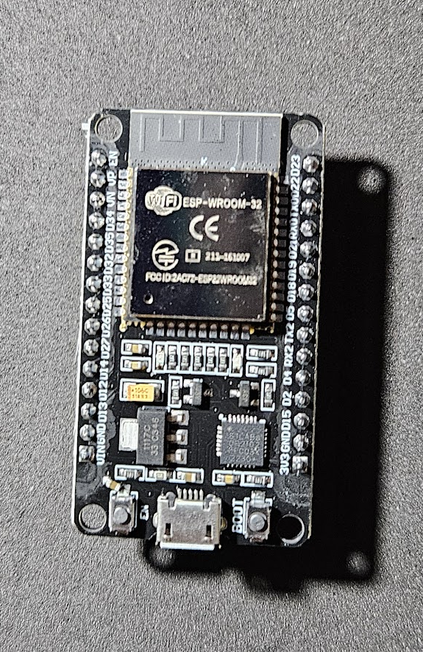
Microcontroller Comparison and Selection
Microcontroller/ Single-Board Comp. | ESP-32S | Raspberry Pi 4 Model B | Arduino Uno R4 WiFi
GPIO Pins | 32 | 40 | 20
Serial Communication | I2C, I2S, SPI, UART | UART, SPI, I2C | UART, I2C, SPI, CAN
Connectivity | Wi-Fi, Bluetooth Classic, BLE | Wi-Fi Dual Band, Bluetooth Classic, BLE, Ethernet | Wi-Fi, Bluetooth Classic, BLE
Cost | 6.00 USD | 75.00 USD | 27.50 USD
Notes:
Multiple microcontrollers were considered when initially designing our system. The main comparison points we had to decide on were the overall processor capabilities such as processing speed, as well as included features and peripheral support, such as WiFi and SPI. However, the main 2 factors influencing our decision were the number of IO pins available, and the cost. The ESP32 was the obvious choice here, as it has sufficient IO pins for our use case, with native support for WiFi and an extremely low price compared to the alternatives.

Slide 15
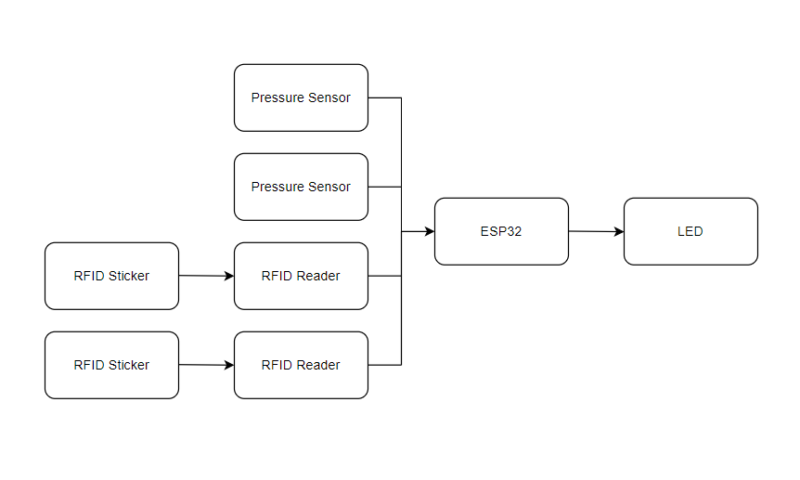
Tool Selection Block Diagram
Notes:
This basic block diagram shows how the tool selection aspect of this project will work. We are using two separate methods of detecting if the tool is present, RFID and pressure sensors. When a tool is requested, the ESP32 will obtain the data on whether or not that tool is present in the drawer, and then it will light up the LED green to show where the tool is if it is present to help the user quickly find it.

Slide 16
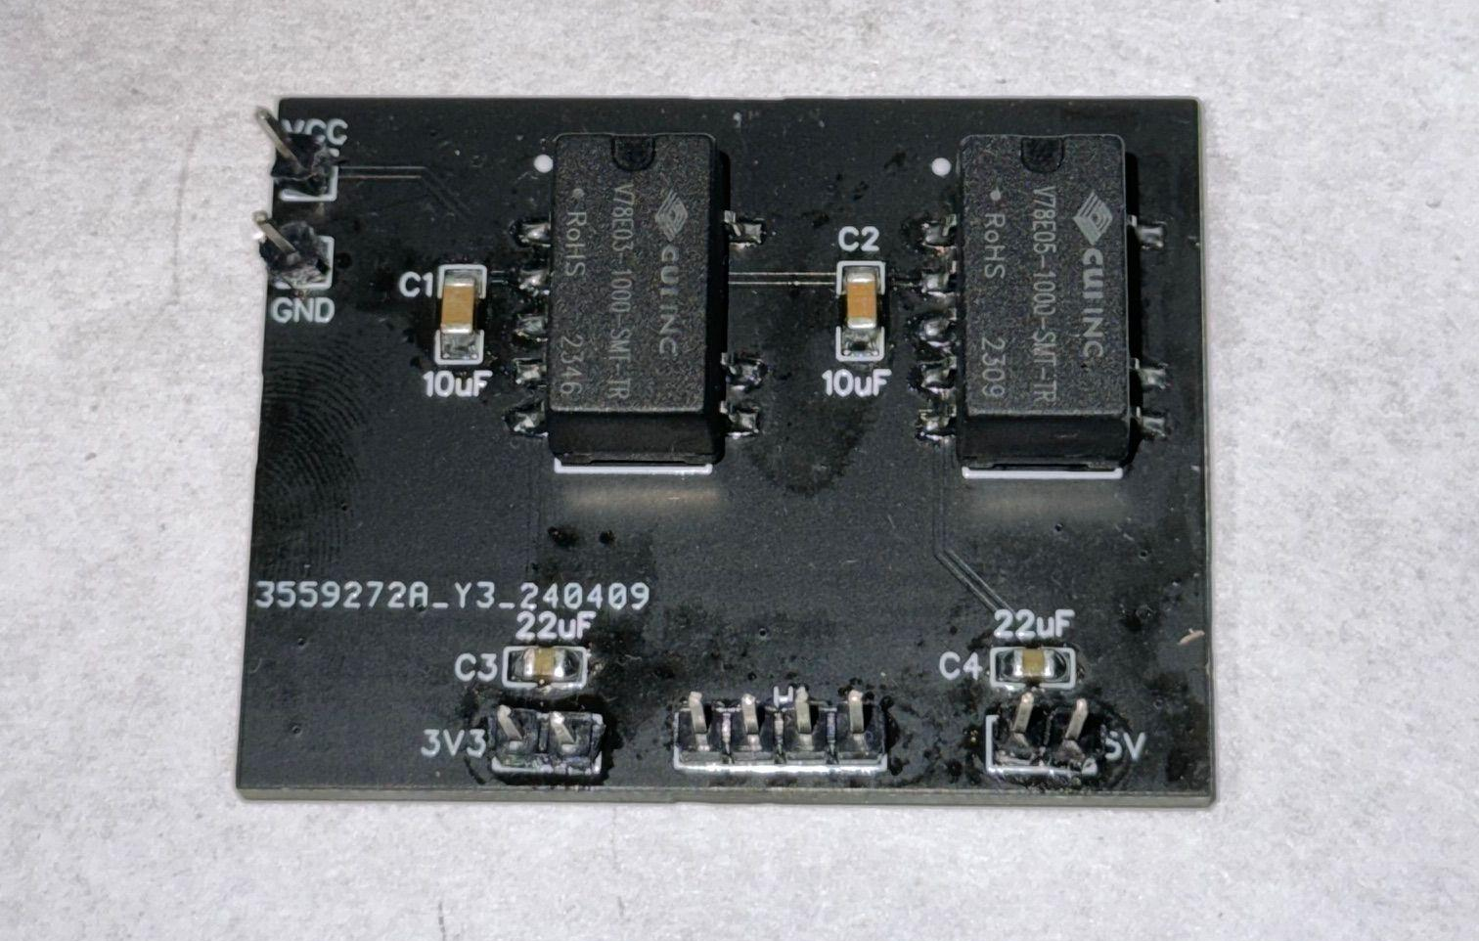
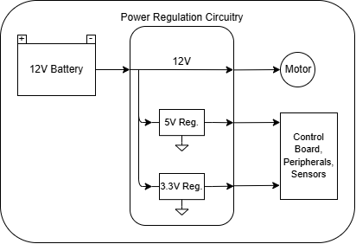
Power Distribution Block Diagram
Notes:
The power distribution for the system overall is very simple. The 12V battery’s output is directly connected to the motor and as such is fed through directly. For powering the mixed 5V and 3.3V components on our board, fully integrated switching regulators were chosen which have a maximum current output of 1A, and require no external heat dissipation. Additionally, these regulators have efficiencies rated at 85-90% depending on input voltage and load current. A development prototype is shown on the left and was used to verify proper functionality for our project.

Slide 17
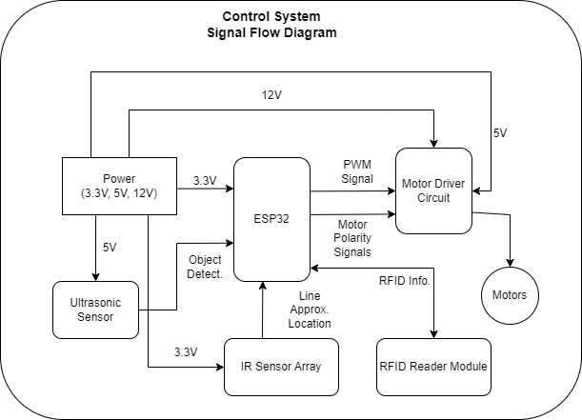
Control System Signal Block Diagram

Slide 18
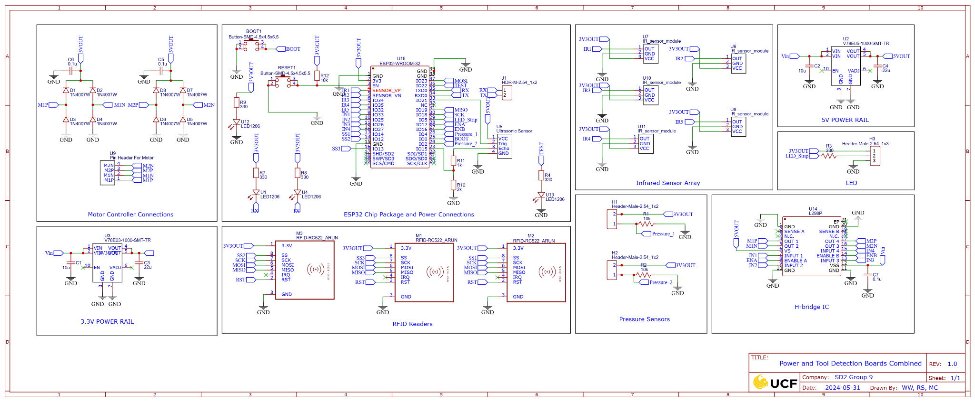
Main Control Board Schematic

Slide 19
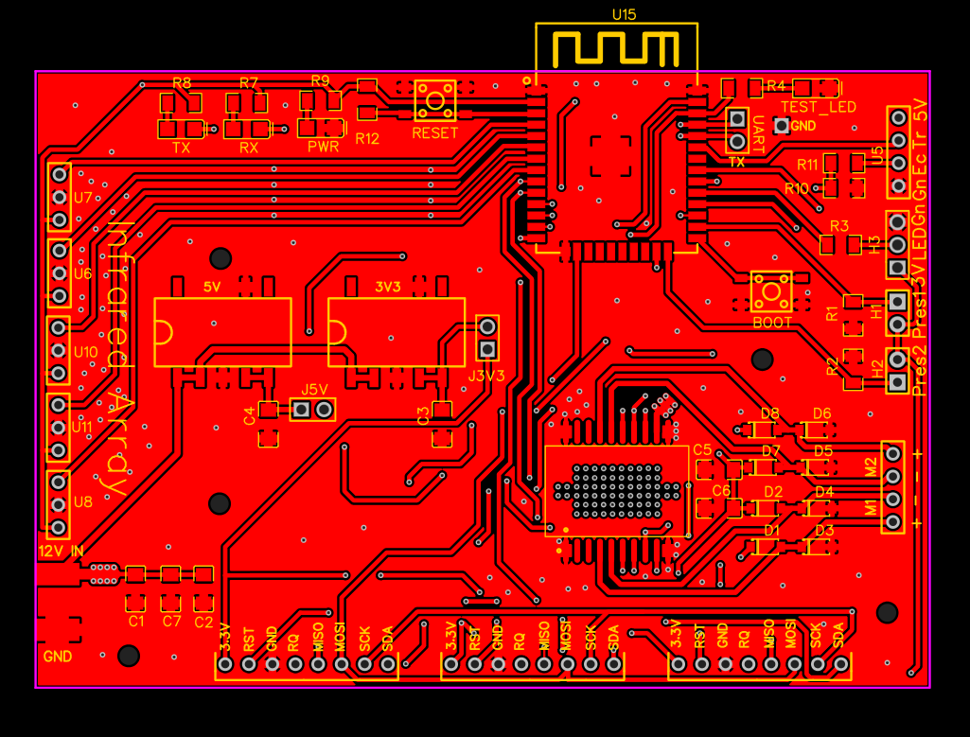
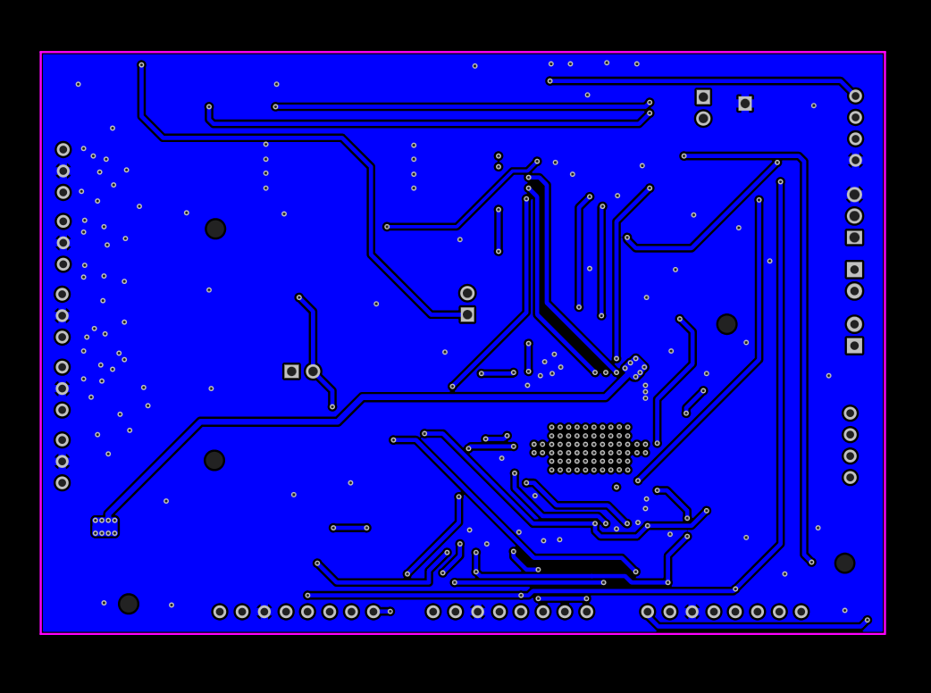
Main Control Board PCB
Notes:
The main control board PCB shown here combines the power distribution, sensors/peripherals, and motor control all on to one board. The main challenge faced was ensuring all IO pins got connected properly through the system, even across the board. This resulted in multiple power and signal paths jumping from the top and bottom copper plane with vias in order to connect everything. Consideration was also made with the H-bridge motor driver IC, which has thermal transfer vias throughout the underside metal pad.

Slide 20

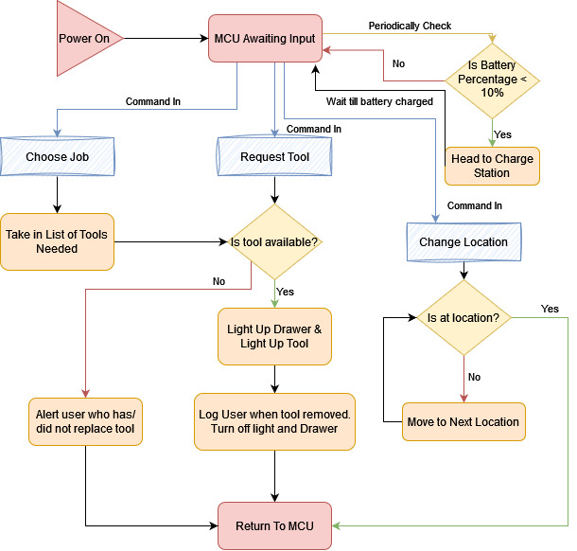
Software Block Diagram
Notes:
Let me walk you through our software block diagram. There are three main commands the robot can receive: Choose Job, Request Tool, and Change Location. For “Choose Job”, the robot checks the list of required tools and verifies their availability. If a tool is missing, it alerts the user; if available, it lights up the drawer and tool. Once the user removes the tool it logs the data, and will update the database upon tool return. The “Request Tool” command follows the same process for a singular tool. The “Change Location” command moves the robot along a black line using 5 IR sensors. Once over a station, it checks the station number with an RFID sticker and determines if it made it to the correct destination. As a stretch goal, we wanted to make the robot periodically check the battery levels and head to a charging station if below 10%. Throughout the processes, the MCU regularly checks the API command queue for new instructions.

Slide 21








Stack Comparison and Selection
Linux
Apache
MongoDB
Express
My SQL
PHP
React
Node
Pros and Cons of LAMP stack
Established with abundant documentation and community support.
Scaleable for medium-sized apps
Handles heavy traffic well
Limited UI libraries
PHP is older thus compatibility issues for newer frameworks
Less suitable for dynamic content
Pros and Cons of MERN stack
Modern Growing Community
Scalable for large applications
High Performance
Rich UI libraries (React)
React for dynamic content
User friendly
JavaScript, which simplifies development
Rapidly evolving, compatibility issues
Potentially more complex setup
Notes:
For the back and front end of this project, we compared the two most popular full stack development options. While the LAMP stack offers established documentation and community support, we opted for MERN due to its modern and rapidly growing community. MERN's scalability for large applications and high performance, coupled with rich UI libraries like React, made it a clear choice for us. The user-friendly nature of MERN, driven by JavaScript, simplified our development process especially since we were more familiar with its capabilities. Ultimately, MERN's dynamic capabilities and evolving ecosystem aligned better with our project's needs, driving our decision towards this stack.

Slide 22
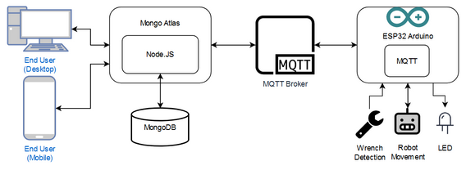
Communication and Data Transfer
User Interactions
Request Processing
Message Broker
Command Execution
Data Storage
Individual Components
Notes:
These are the steps involved in communicating with Wrench Monkey. First we have our end users who interact with our system through either a desktop website interface or the mobile application. These applications send and retrieve data from MongoDB Atlas, our cloud-based database service. This stores information such as tool detection, user actions, and status updates. Node JS, running on our server, processes these requests from the end users. Next, Atlas and Node JS communicate with the MQTT broker, which serves as a lightweight messaging protocol designed for constrained devices and unreliable networks making sure commands are delivered. Finally the ESP32 sends and receives commands from the broker executing the appropriate action. This process ensures real-time communication between end users and the Wrench Monkey.

Slide 23




Development Technologies
Expo is an application for testing React apps
Mobile App for IOS and Android to stream React App
Real-time updates for modifications
No need for emulators
Use of multiple devices at the same time
REST API Interface is for communication between different systems
Uses HTTP requests to GET, POST, PUT, or DELETE data
Allows the ESP32 to interact with server and database
Uses a queue based system to send commands
No need for port forwarding
Arduino IDE is the Integrated Development Environment for programming the ESP32
Supports C or C++ languages
Provides tools for compiling and uploading code to the ESP32
Has serial monitor for debugging purposes
Extensive public libraries with examples for each case
Figma is the design tool used for prototyping user interfaces for web and mobile applications
Real-time collaboration on designs
Wide range of design components and plugins
Preset dimensions of desktop and mobile screens
Simulation of user interactions
Notes:
The following are the key development technologies we used for our project. Firstly, Expo is an application that allows for efficient testing of React applications. It supports both iOS and Android platforms, enabling us to stream the React app easily. One of its standout features is the ability to update in real time as we make modifications to the code, speeding up the development process. Next, REST API serves as the communication bridge between Wrench Monkey and our server, using HTTP requests to perform operations such as retrieving, updating, and deleting data. By employing a queue-based system, we can reliably manage and send commands without the need for port forwarding. Arduino’s IDE is the program we selected for coding the ESP32 microcontroller directly. This program supports C and C++ languages, along with numerous libraries essential for communication, allowing for easier writing and debugging of code. Lastly, Figma is the collaborative design tool we used to prototype the user interfaces for desktop and mobile use. It provided a wide range of design components and dimensions, ensuring our designs would fit the users' needs.

Slide 24

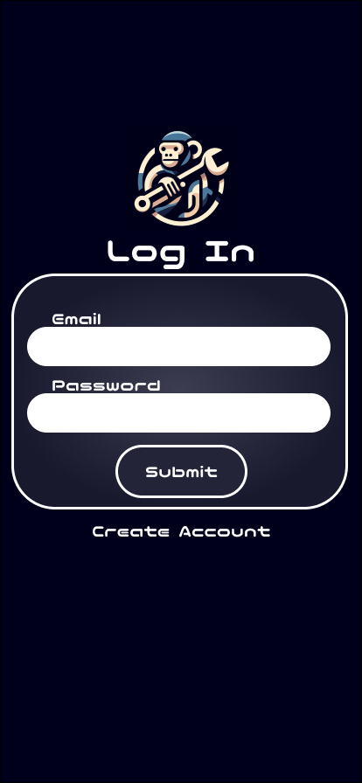
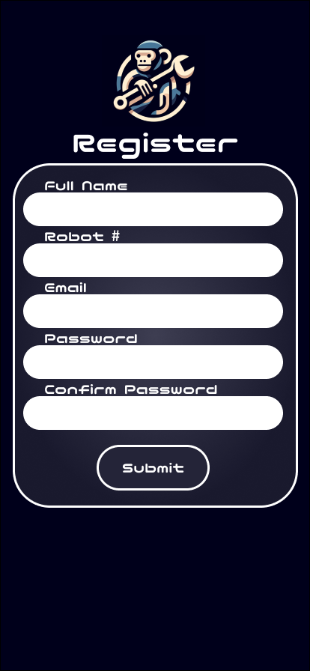


Mobile App Interface
Loading Screen as a placeholder during database pull
Log In Screen with account creation option
Registration Page for user details entry
Main Screen displaying robot status
Emergency stop button while robot is moving
Notes:
Our mobile app interface is designed for intuitive user interaction. When launching the app, a loading screen briefly appears during database operations. Users are then greeted by a login screen, with an option to create a new account.Upon selecting the account creation option, users are directed to a registration page where they input details such as their robot number which ties accounts to specific robots. We've incorporated a stretch goal of email confirmation to enhance security. After completing the registration process, users are prompted to log in using their email and password, which are then securely stored on their device for convenience. Once logged in, the main screen of the app displays two primary buttons: 'Tools' and 'History'. The 'Tools' section provides users with a comprehensive view of available tools, allowing them to add, delete, or check out specific tools as needed. Meanwhile, the 'History' section offers insights into the checkout history of tools. The main screen also displays the current status of the Wrench Monkey robot, providing users with real-time updates on its activities and movements. As an added safety measure, should the robot make an unexpected move, an emergency stop button becomes available while traveling from station to station.

Slide 25
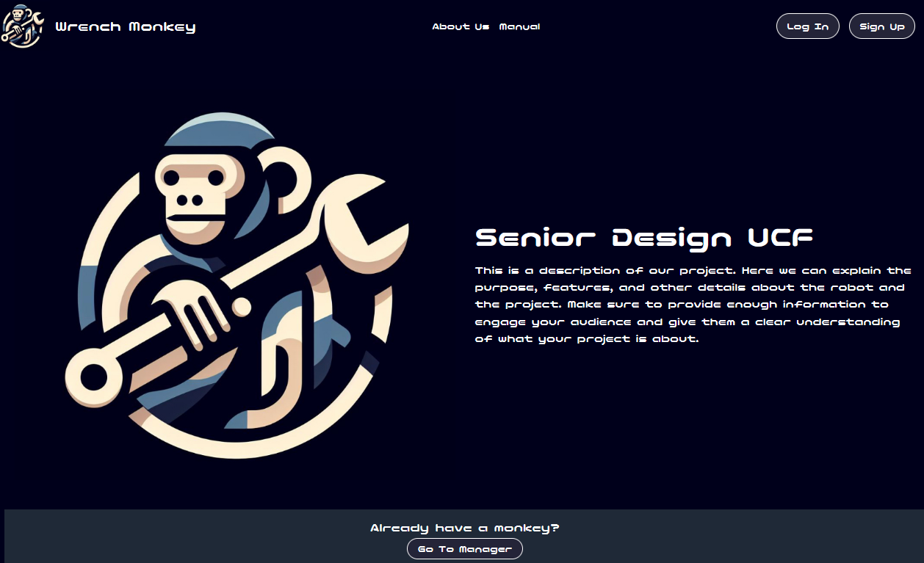
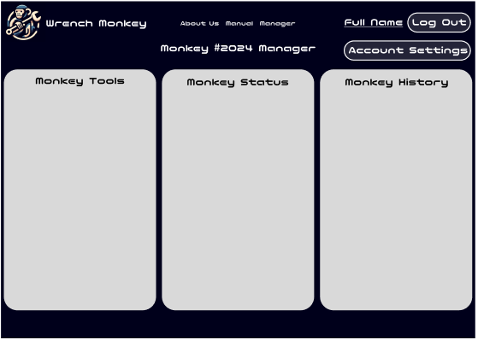
Desktop Website Interface
UI elements inspired by the mobile app for a consistent user experience
Addition informational pages such as About Us and a Usage Manual
Accessibility options include alternative text and color changes for button selection
Manager page offers a comprehensive interface with all information accessible on a single page
Website subject to design changes, example based off the mobile application
Notes:
The desktop website interface complements our mobile app, offering users a familiar experience on larger screens. The home page is designed for simplicity and intuitive navigation, providing quick access to essential features. While the website's design is subject to changes, the example provided is based on the mobile application's layout and functionality.

Slide 26
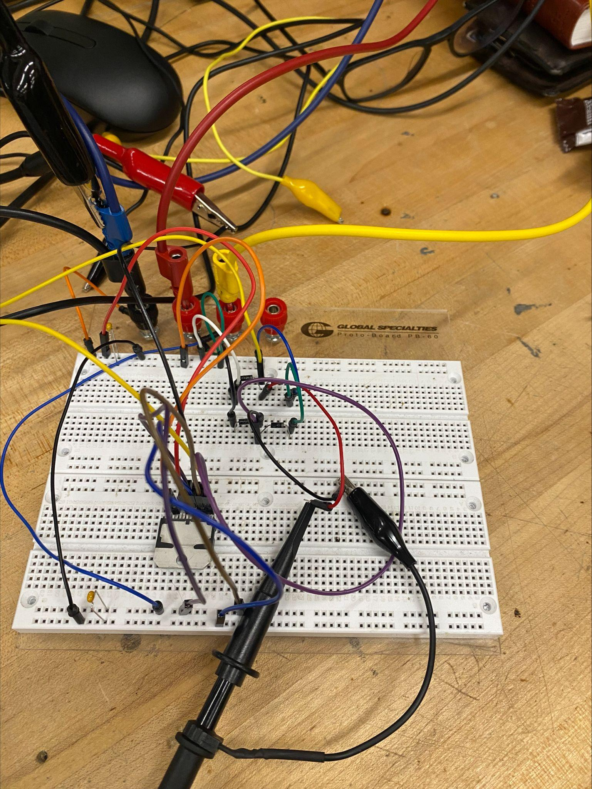
Testing: Line Following
H-bridge circuit testing
IR sensor calibration
Bang-bang control approach
PID control tuning

Slide 27
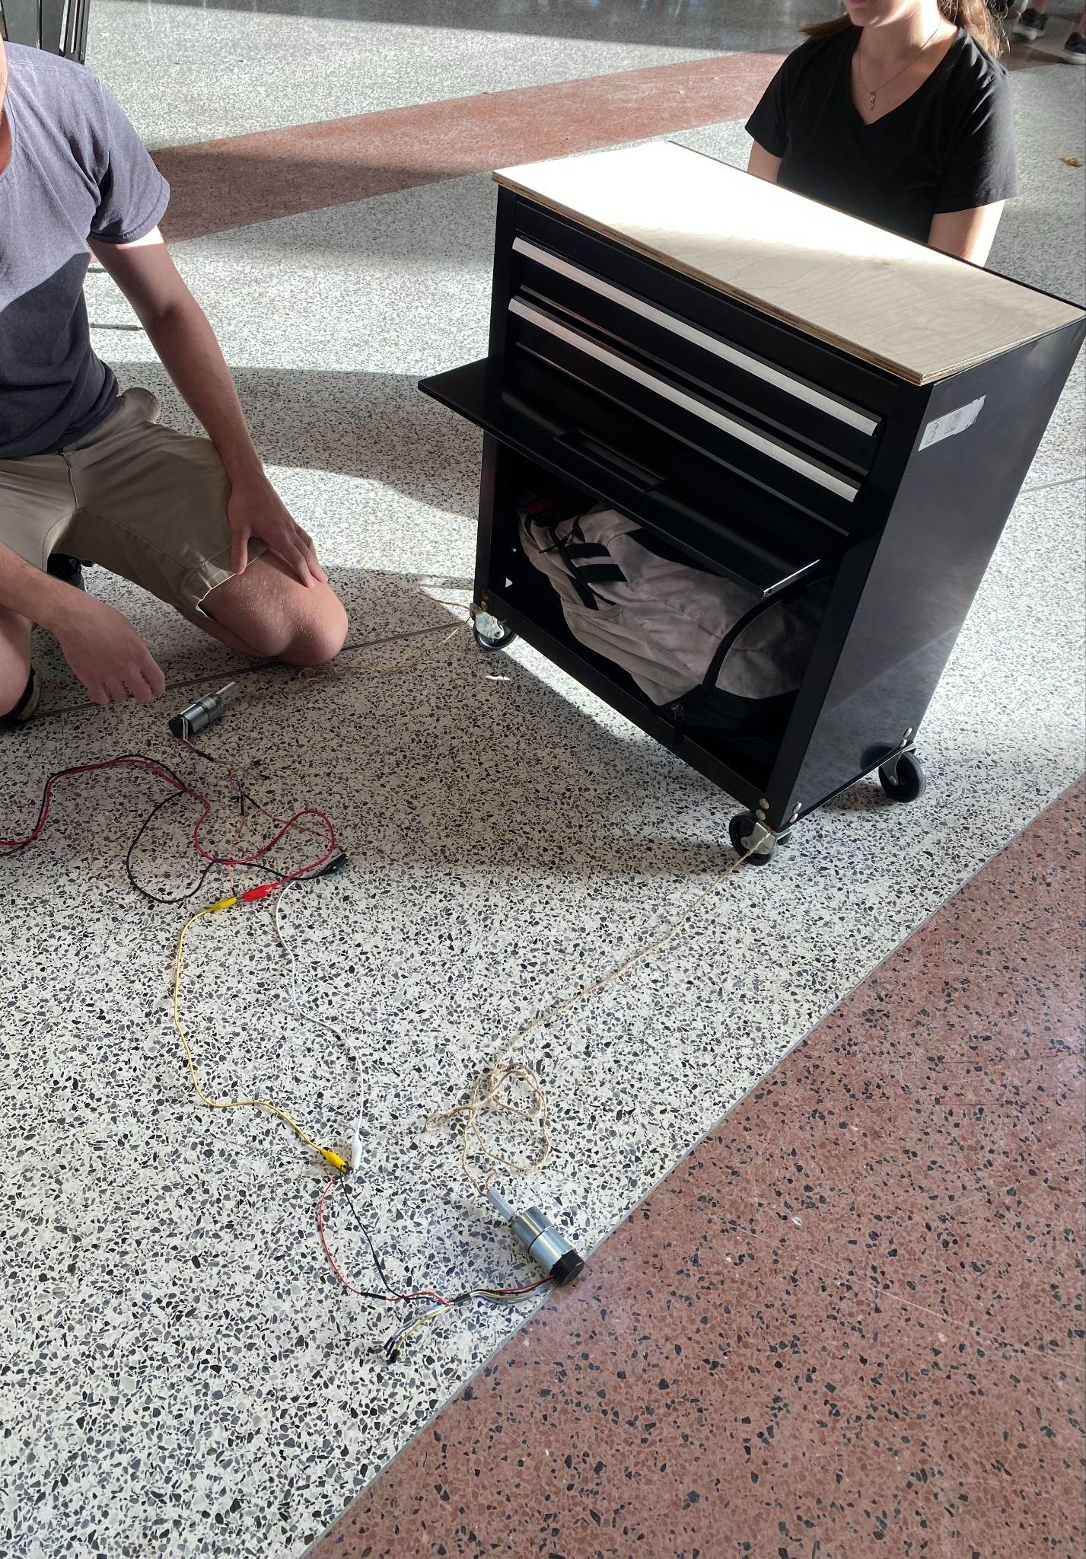
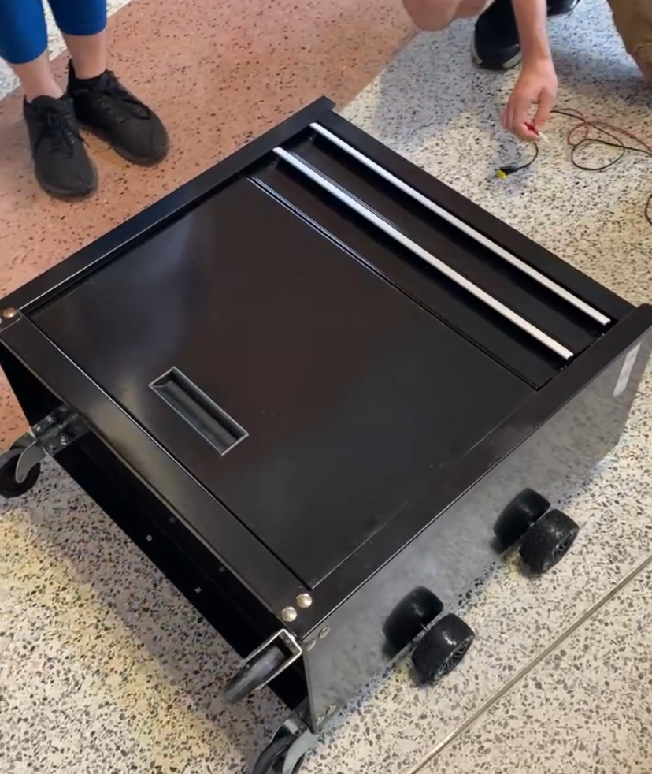
Testing: Motors
Hook up the motors to a power supply and test that the torque is strong enough
Construct the Chassis
Test the system with the weight of the toolbox
Notes:
To test that the selected motors would work for this project, we first hooked them up to a power supply and used twine attached to the toolbox to test that it would have sufficient torque to pull the final product, as shown in the image on the left. Next, we constructed the chassis by attaching the motors and wheels, and then we placed the toolbox on it to test it’s overall functionality. The toolbox is sideways here as the wheels had yet to be removed, and in both tests the toolbox had a heavy backpack in it to prove that it would be able to support the weight once the tools and battery have been added.

Slide 28
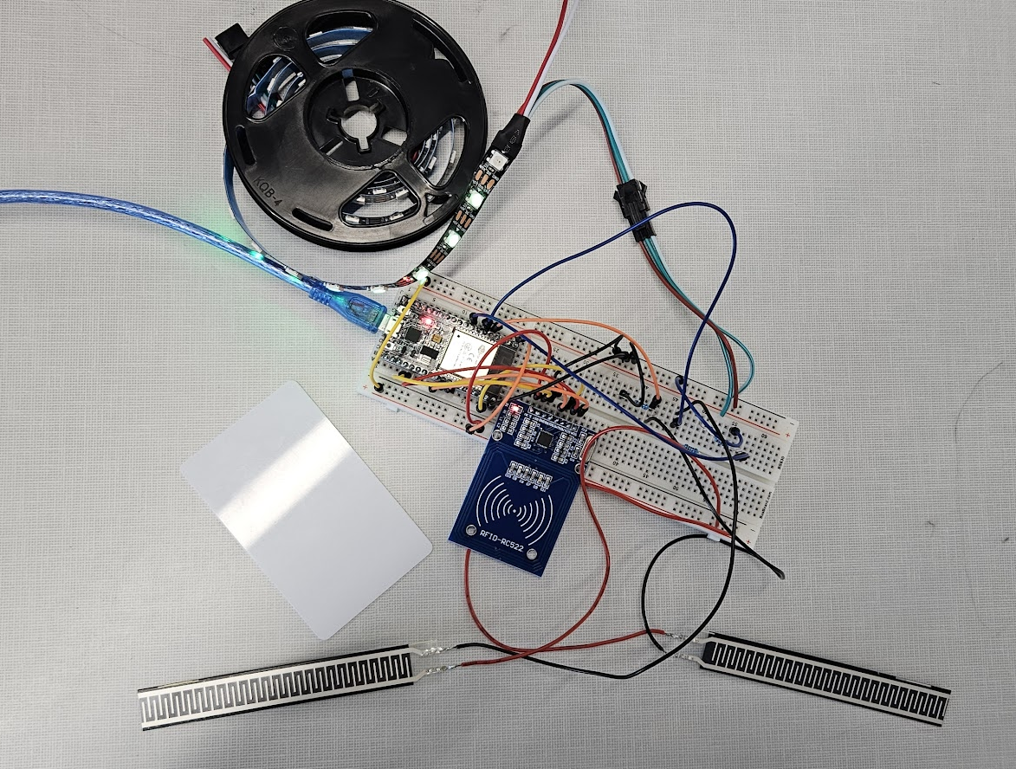
Testing: Tool Detection
Connect a pressure sensor to the ESP32 via a breadboard and test
Connect the RFID reader to the ESP32 via a breadboard and test
Connect the LEDs to the ESP32 via a breadboard and test
Test system as a whole
Notes:
To test the tool detection system, first the pressure sensors were connected to the ESP32 via a breadboard and their functionality, as well as their ability to detect tools within the foam insert created, was tested. Next the RFID reader was connected and tested for functionality. Finally the LEDs were added and tested, and code was written to allow the sensors and the RFID reader to each interact with a different section of the individually addressable LED strip to signify if a tool is present or not.

Slide 29
Budget and Financing
Item | Quantity | Unit Cost | Total
Toolbox | 1 | 15.00 | 15.00
Custom PCBs | 1 | 9.00 | 9.00
MCU (ESP32) | 1 | 2.68 | 2.68
Lead Acid 12v Battery | 1 | 19.00 | 19.00
LED Strip (12ft) | 1 | 13.99 | 13.99
RFID Sticker Roll | 1 | 16.59 | 16.59
RFID Module | 3 | 3.00 | 9.00
Ultrasonic Sensor | 2 | 2.00 | 4.00
IR Sensor | 5 | 2.40 | 11.99
Strain Gauge | 2 | 6.50 | 13.00
H-Bridge (L298P) | 3 | 10.87 | 32.61
Diodes (1N4007W) | 100 | 0.0063 | 0.63
Resistors | 50 | 0.05 | 2.50
Capacitors | 50 | 0.05 | 2.50
½x12x24in Birch Plywood | 1 | 9.88 | 9.88
Block Insert Bearing | 4 | 2.25 | 9.00
Uxcell Hex Coupler | 4 | 2.50 | 10.00
Linear Motion Rods | 2 | 4.25 | 8.00
Shaft Lock Collar | 10 | 0.89 | 8.89
Tires | 4 | 3.74 | 14.96
Hex Wheel Adapter | 2 | 2.98 | 5.96
DC Geared-Down Motor | 2 | 33.99 | 67.98
3D Printed Items | 6 | 0.66 | ~4.00
Total | $ 291.16
Notes:
For our budget and financing, we kept track of all the expenses for the Wrench Monkey project. The chart on this slide shows the individual items, quantity, unit cost, and total cost for each item we bought. Fortunately, some parts came in packages with more than one of the needed amount, which helped lower the overall cost per part. The chart is up to date with everything we've bought thus far leaving the grand total of our expenses to be 291 dollars, which is UNDER our original estimated budget by about 84$.

Slide 30
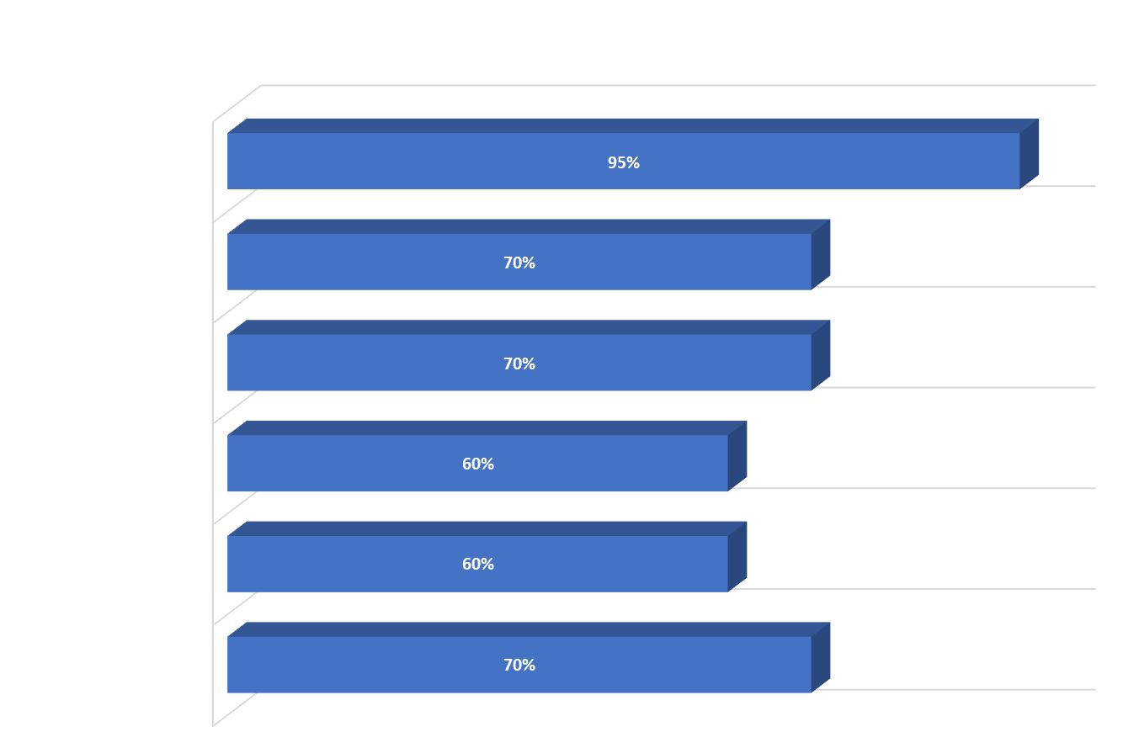
Current Progress
Notes:
As can be seen here, we have already completed a majority of our research for this project and we have made decent progress in the other areas as well. Overall, we predict that at this point we are around 70% done.

Slide 31
Next Steps
Ordering, assembling, and testing the PCB design
Completing the website software
Completing assembly of all sensors and components
Testing assembled project
Notes:
Our next steps to complete the project include ordering, assembling, and testing our PCB, and then completing the software to allow us to control the Wrench Monkey. We also need to finish assembling and mounting all or our sensors and other components to the toolbox, and then test our final project and troubleshoot until it meets our requirements.

Slide 32
Questions?

